Slide 1

How early
can we know?
CSE4074 | FORENSIC ANALYTICS | PROJECT REVIEW 3: FINAL RESULTS
Early Detection of Money Laundering Rings using Temporal Transaction Network Analytics and Explainable Risk Scoring
Keerthana A R (23MIA1096) Raagav (23MIA1052)
Vellore Institute of Technology, Chennai | Fall 2026-27 | Prof. Dr. S. Johanan Joysingh
Notes:
Open with the question, not the title: a laundering ring is only obvious once the money has moved. Our project asks how many days earlier a transaction network can tell us a ring is forming, and whether we can explain why. Everything in the next 30 slides is measured on the AMLSim simulator, and every screenshot is from the running dashboard.

Slide 2
Our answer, in four numbers
A formation-stage early-warning system, evaluated honestly on the 30 rings the simulator lets us observe completely
29 of 30
17 of 30
82%
14
rings seen by the candidate queue
warned before the ring completed
alert precision: 9 of 11
dashboard pages
84% of ring transactions covered
median lead 4.0 days (the queue)
0.004 false alerts per day
every number traces to a result file
THE PROBLEM
WHAT WE BUILT
WHAT WE FOUND
Rings are usually recognised after the money has moved.
Label-free candidates, an explainable daily score, and a lead-time evaluation.
The queue holds the earlier signal; alerts are precise but late; part of the signal is a simulator shortcut.
Notes:
This is the whole talk on one slide. The candidate queue sees 29 of 30 evaluable rings and warns before completion for 17 of them. The alerts are precise, 82 percent, but early for only 5 rings. The dashboard has 14 pages and each number traces back to a result file. The rest of the deck shows where each of these numbers comes from.

Slide 3
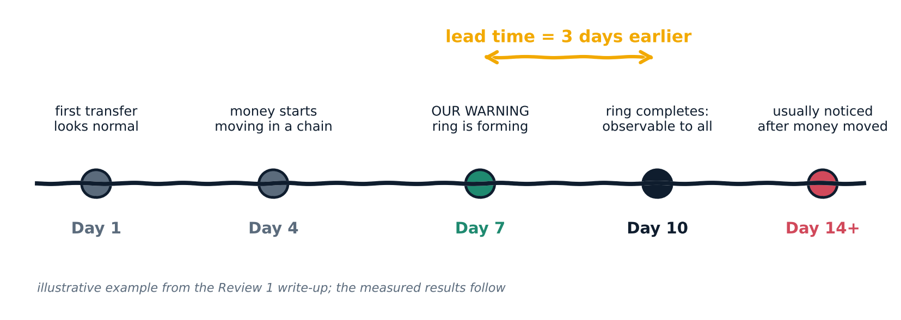
Rings are usually seen after the money has moved
Layering hides the origin of funds in cycles, chains and fans, so single transfers look normal
A transfer looks normal
The ring lives in relationships
Value is warning days
Amounts and timing are ordinary on their own.
Cycles, chains and fans emerge across days.
Lead time = completion day minus warning day.
Notes:
A single transfer between two accounts looks ordinary. The suspicion is in how transfers connect over time. In the example from our Review 1 write-up, the network is recognisable as a ring on day 7 but is only fully observable on day 10. Those three days are the lead time, and measuring them is the central contribution. The measured results follow.

Slide 4

Six research gaps, six unique solutions
G1 to G3 were promised in Review 1; G4 to G6 emerged when we evaluated honestly
G1
Formation-stage early warning is missing
Label-free candidates from structure and first-time accounts
Alert Queue
G2
Pattern evolution into a ring is not tracked
Pattern events per candidate; score recomputed every day
Pattern Analytics, Temporal Evolution
G3
Lead time before a ring is observable is not measured
Completion-based lead time on 30 rings: queue against alerts
Lead-Time Analytics, Warning Timeline
G4
Black-box scores give no evidence
Four-component score, calculation card, evidence trail
Why Flagged, Ring Investigation
G5
Gains on simulated data may be a shortcut
Controls: newness rule, no-novelty model, random policy
Ablations & Controls
G6
Rare positives and small N hide weak models
PR-AUC, confusion matrices, Wilson intervals, stability
Model Performance, Evaluation
Notes:
The first three gaps come straight from the Review 1 write-up: formation-stage early warning, tracking pattern evolution into a ring, and measuring lead time. While evaluating, three more appeared: scores with no evidence, results that may be a simulator shortcut, and rare positives that hide weak models. Each gap has one solution module and one or two dashboard pages that show it.

Slide 5

Five Review 1 promises, five delivered results
What we said we would build, and what the dashboard now shows
1
2
3
4
5
PROMISED IN REVIEW 1
PROMISED IN REVIEW 1
PROMISED IN REVIEW 1
PROMISED IN REVIEW 1
PROMISED IN REVIEW 1
Detect during formation
Track change over time
Analyse sequences
Measure how early
Preserve evidence
DELIVERED
DELIVERED
DELIVERED
DELIVERED
DELIVERED
171 candidates, no labels; queue sees 29 of 30 rings
720 daily windows; score recomputed every day
179 pattern events, 4 types; layering behind all 5 early alerts
Queue: 17 of 30 early (4.0 d). Alerts: 5 of 30 (1.0 d)
Accounts, transfers and IDs behind every score
Alert Queue
Temporal Evolution
Pattern Analytics, Alert Log
Lead-Time, Warning Timeline
Ring Investigation, Data Explorer
Not delivered yet: secondary validation on Elliptic2 and a published temporal-GNN baseline are future work.
Notes:
In Review 1 we promised five things: detect during formation, track change over time, analyse sequences, measure how early, and preserve evidence. Each card shows the delivered result and the page where you can see it. We were also honest about what is not delivered: secondary validation on Elliptic2 and a published temporal graph neural network baseline remain future work.

Slide 6
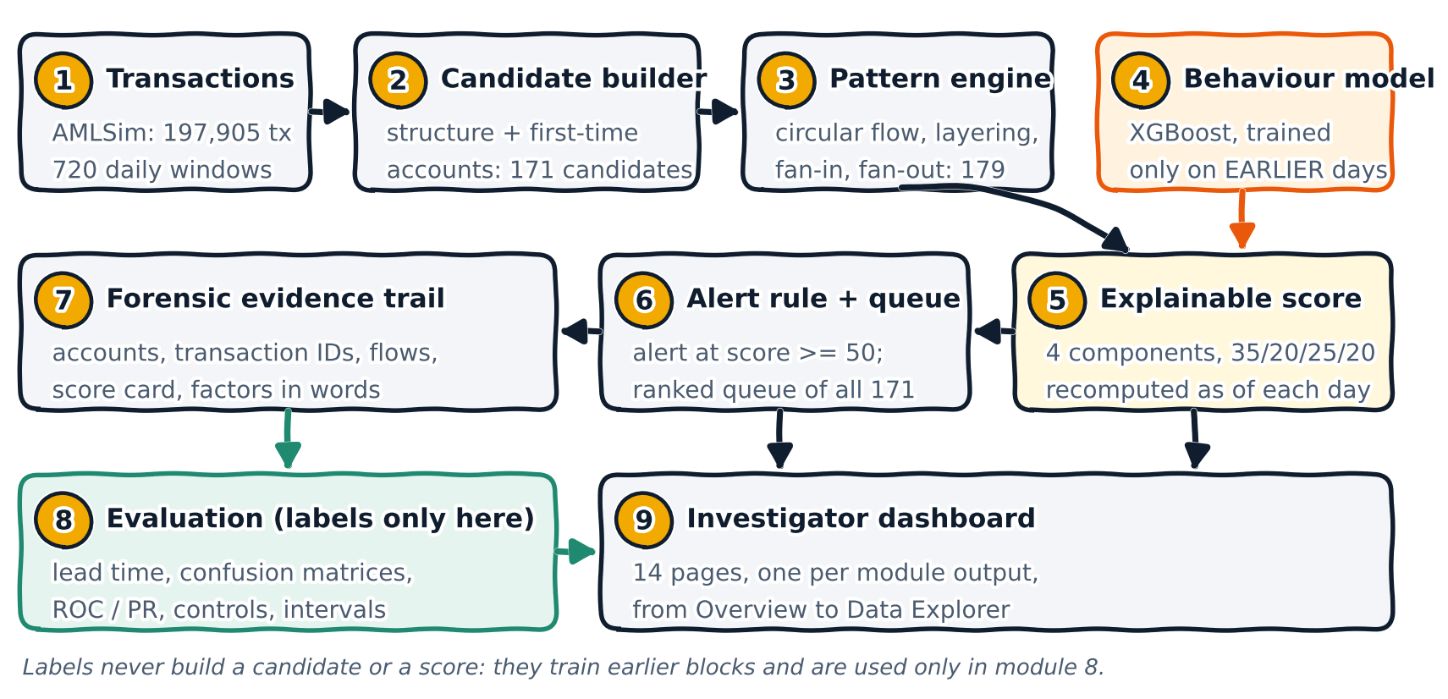
The system on one page
Notes:
Read this left to right and then snake down. Transactions become candidates built from structure and from first-time accounts. The pattern engine labels what each candidate looks like. The risk score combines the patterns with a behavioural model that was trained only on earlier days, and the score is recomputed every day. A score of 50 raises an alert and the whole queue stays ranked. Every candidate gets an evidence trail. Ground-truth labels enter only in module 8, the evaluation, and all of it is served by the 14-page dashboard.

Slide 7
Fourteen pages, fourteen deliverables
Every page is one module of the pipeline; the number is its place in the architecture
9
Overview
6
Alert Queue
7
Ring Investigation
5
Why Flagged
5
Temporal Evolution
171 candidates, 11 alerts, warning cards
All 171 ranked; filter by pattern or alert
Evidence trail and the warning given
Four components, factors in words
Score calculation card, day by day
3
Pattern Analytics
8
Lead-Time Analytics
8
Warning Timeline
6
Alert Log
3
Pattern Evidence
179 events, 4 types, and what is not detected
Queue 17 of 30 early; alerts 5 of 30
30 rings aligned at completion
11 alerts: then, now and the verdict
Pattern count against score: rho 0.03
4
Model Performance
2
Ablations & Controls
8
Evaluation
1
Data Explorer
+
Around the pages
Four model families, one protocol
The newness rule matches the model
Confusion matrices, ROC, PR, intervals
Every transaction, labelled only to evaluate
README, HTML explainer, tests, fresh-clone rebuild
Notes:
This is the map for the rest of the talk. The dashboard has fourteen pages. Each tile shows the module number from the architecture and the headline output of that page. The fifteenth tile is everything around the dashboard: documentation, tests and a reproducibility check that rebuilds the results from a fresh clone.

Slide 8
Real simulator data, a leakage-safe protocol
Labels train earlier blocks behind a 14-day gap and are used to evaluate; they never build a candidate or a score
197,905
12,043
720
100
671
transactions
accounts
daily windows
labelled rings: 40 cycle, 30 fan-in, 30 fan-out
alert-linked transactions
Account-day forecasting (all four model families)
warm-up
training: days 120 to 417
validation
test
Ring candidates and risk scores
warm-up: no candidates built
scored period: candidates built and scored as of each day (480 days)
Evaluation of rings (ground truth used here only)
30 of 100 rings lie wholly inside this period and complete in the data: these are evaluated
0
120
240
418
576
720
day of the simulation (one window per day)
Notes:
The data is the AMLSim simulator: 197,905 transactions, 12,043 accounts, 720 daily windows and 100 labelled rings. The first 120 days are warm-up. Account-level forecasting trains on days 120 to 417, validates on 432 to 561 and tests once on 576 to 719, with a 14-day gap between periods. Candidates are built and scored from day 240, and only 30 of the 100 rings lie entirely inside that scored period, so those 30 are what we can evaluate.

Slide 9
Two sources build 171 candidates, no labels
MODULE 2 · CANDIDATE BUILDER | ALERT QUEUE and ABLATIONS pages
Structure is clean but late; first-time accounts are early but noisy; together they see 29 of 30 rings
A
Structure candidates: 19
Unordered cycle closure and path-like chains inside a 21-day window. Cycle edges arrive in arbitrary order, so no ordering is required.
B
First-time-account groups: 152
Seeds are transactions whose sender or receiver was never active before, grouped by a shared account and by a shared hub (slow-drip fans).
Notes:
Candidates are built from transaction fields only. The structure source finds unordered cycle closures and path-like chains in a 21-day window; there are 19 of them. The second source groups first-time accounts, meaning accounts whose first ever transaction is in the group; there are 152. The chart is from the ablation on the dashboard: structure alone sees 17 of 30 rings but warns early for only 6, first-time accounts alone see 13 but warn early for 12, and together they see 29 and warn early for 17. The two sources complement each other.

Slide 10
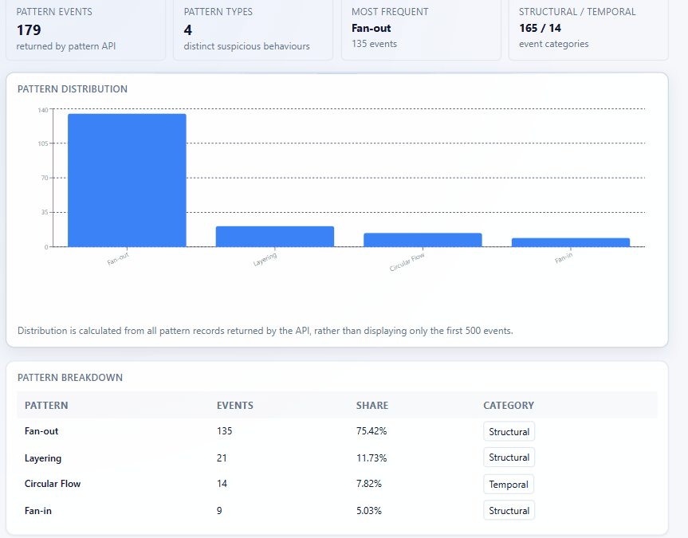
Four patterns, counted, weighted and explained
MODULE 3 · PATTERN ENGINE | PATTERN ANALYTICS page
179 pattern events on the candidates; the page also states what this pipeline does not detect
179
4
pattern events
pattern types
Pattern | Events | Weight in score
Fan-out | 135 | 1
Layering | 21 | 2
Circular flow | 14 | 3
Fan-in | 9 | 1
Stated on the page: split-merge, rapid pass-through, repeated intermediary and escalating connectivity are not produced by this pipeline.
Notes:
The pattern engine reports four types under the project's original names: circular flow, layering, fan-in and fan-out. There are 179 events; fan-out dominates in count, but the page and the evidence show that fan-out is also where almost all the noise is. Each pattern has a weight in the fund-flow part of the score: circular flow 3, layering 2, fan-in and fan-out 1. We also state on the page that four of the original eight detectors, split-merge, rapid pass-through, repeated intermediary and escalating connectivity, are not produced by this pipeline.

Slide 11
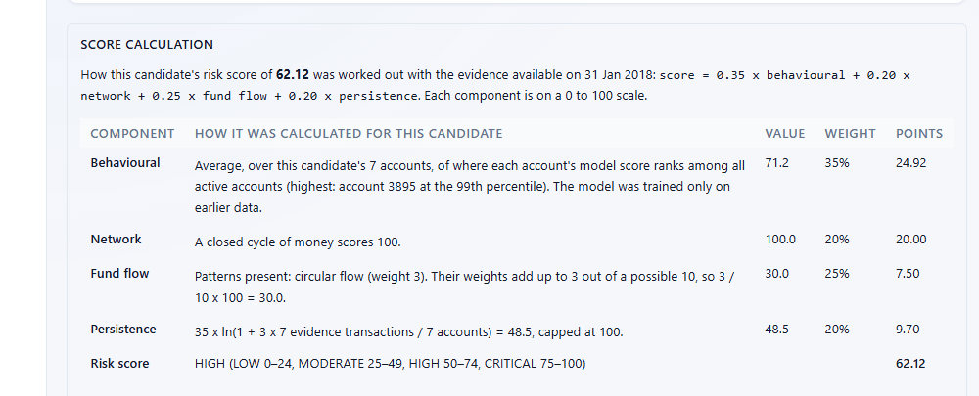
Every point of the score is explained
MODULE 5 · EXPLAINABLE RISK SCORE | TEMPORAL EVOLUTION page (score calculation card)
Four components, recomputed as of each day, with the arithmetic written out from the code's own constants
score = 0.35 × behavioural + 0.20 × network
+ 0.25 × fund flow + 0.20 × persistence
Behavioural 35%
Network 20%
Percentile of the model score of the candidate's accounts
Closed cycle = 100; path-like chain = 60
Worked example: RING0088
Fund flow 25%
Persistence 20%
24.92 + 20.00 + 7.50 + 9.70 = 62.12
Sum of pattern weights ÷ 10 × 100
35 × ln(1 + 3 × transactions ÷ accounts), cap 100
HIGH (50 to 74) and at or above the threshold of 50, so an alert is given on 31 Jan 2018
Notes:
The score is an investigative priority, not a probability of guilt. It is 0.35 behavioural plus 0.20 network plus 0.25 fund flow plus 0.20 persistence. The screenshot is the score calculation card for RING0088: behavioural 71.2 gives 24.92 points, a closed cycle scores 100 on network for 20 points, circular flow gives 30 for 7.5 points, and persistence 48.5 gives 9.7 points. They add up to 62.12, which is HIGH and at least 50, so an alert is given. The weights, bands and threshold come from the configuration and were fixed before the evaluation.

Slide 12
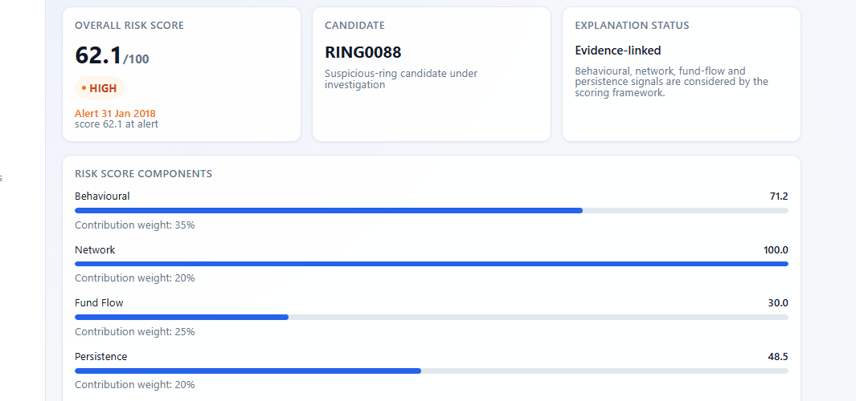
Bars an investigator can read, factors in words
MODULE 5 · EXPLANATION | WHY FLAGGED page
Each bar is proportional to its component, with its contribution weight beside it
Top contributing factors, written from the evidence
1
Mean account score percentile 71 across 7 accounts (highest: account 3895 at the 99th percentile)
2
Structure: circular flow (network completeness 100/100)
3
Combines 1 pattern type; strongest: circular flow
Contribution weights 35 / 20 / 25 / 20 sit beside each bar, so the total can be checked by hand against the score calculation card.
7 evidence transactions across 7 accounts (1.00 per account)
4
Notes:
Why Flagged is the investigator's view of the same score. The four bars are the four components with their weights, 35, 20, 25 and 20 percent. Below them the page writes the top contributing factors in plain words, such as the mean account score percentile across the candidate's accounts and the structure found. Because these strings are generated from the same numbers as the score, an investigator can recompute any of them.

Slide 13
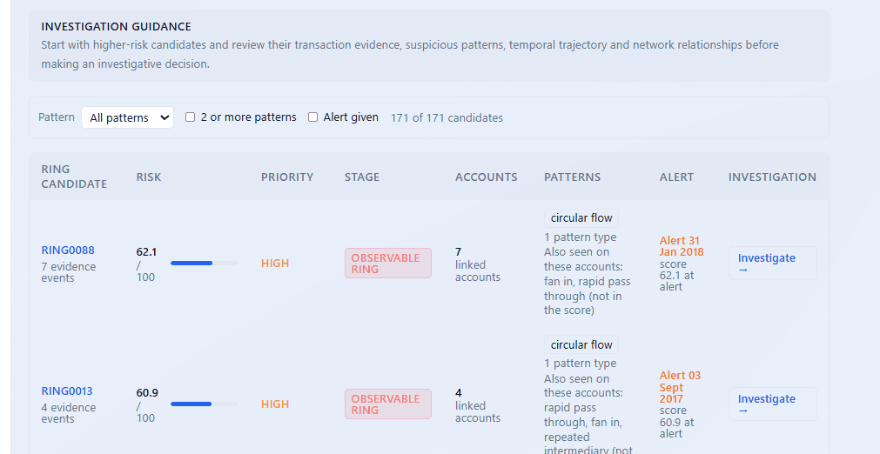
One threshold, one ranked queue
MODULE 6 · ALERT RULE + QUEUE | ALERT QUEUE page
An alert is raised at a score of 50, fixed before the evaluation; the queue keeps every candidate
11
8
alerts at score 50
HIGH, 0 CRITICAL
Filters: by pattern, 2 or more patterns, alert given
An orange dot and an alert badge mark alerted candidates on every candidate page
The threshold was fixed before the evaluation and was not tuned to the results
Near misses: RING0010 (49.4), RING0149 (49.4) and RING0126 (49.3) have no alert, so the threshold is a dial.
Notes:
The queue lists all 171 candidates ranked by risk, with filters for pattern type, candidates with two or more patterns, and candidates that raised an alert. The Alert column shows the alert date and the score at the alert, and the same badge now appears on every candidate page. There are 11 alerts, 8 candidates in the HIGH band and none CRITICAL. Three candidates sit at 49.3 to 49.4 without an alert, which is why we later report operating points at six thresholds instead of one number.

Slide 14
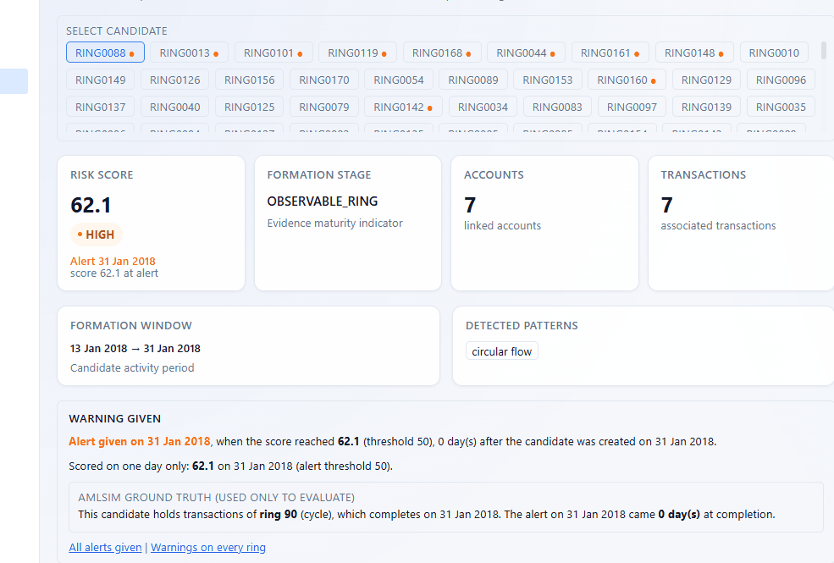
From the alert to the exact seven transfers
MODULE 7 · FORENSIC EVIDENCE TRAIL | RING INVESTIGATION page
RING0088 closes a cycle on 31 Jan 2018 and the alert arrives the same day
1
Alert and warning given
Alert on 31 Jan 2018 at score 62.1, 0 days after the candidate was created
2
Ground truth, only to evaluate
Ring 90 (a cycle) completes the same day: lead 0 days
3
Evidence you can inspect
7 accounts and 7 transfers (13 to 31 Jan 2018) with transaction IDs
4
Context, never scored
Other detectors' patterns on these accounts do not separate rings (AUC 0.34)
Notes:
Ring Investigation is the forensic heart of the dashboard. For RING0088 it shows the risk score and the alert badge, the formation window from 13 to 31 January 2018, the pattern, and a Warning Given panel. That panel includes an AMLSim ground truth box, clearly marked as used only to evaluate, which says the candidate holds transactions of ring 90, a cycle that completes the same day, so the lead is zero days. Below the screenshot the page lists the seven accounts, the seven transfers with amounts and dates, and the transaction IDs. Patterns that other detectors found on these accounts are shown as context only, because a measured test showed they do not separate rings from normal traffic.

Slide 15
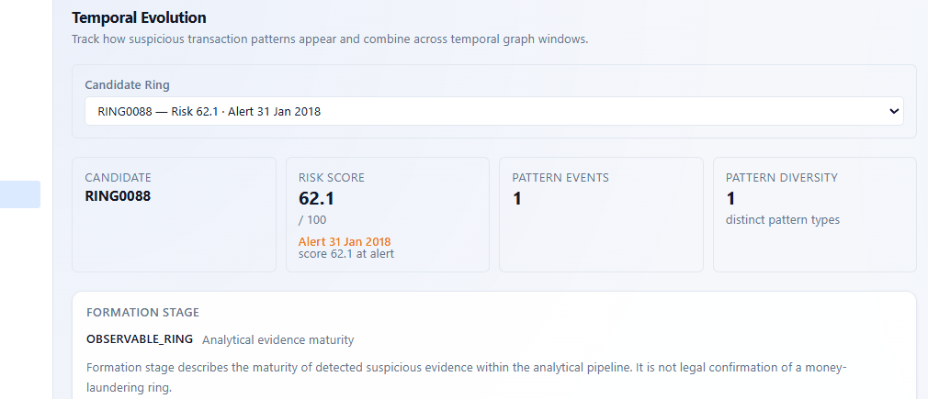
The score is recomputed as of every day
MODULE 3 and 5 · AS-OF-DAY SCORING | TEMPORAL EVOLUTION page
Each row uses only the evidence available on that day, and a model trained only on earlier data
82%
of the 107 candidates with 2 or more days of evidence lost over 10 points of behavioural score after their first day (median 51 to 27)
120-day blocks
14-day purge gap
Dates in UTC
A re-analysis of the stored score histories. The likely cause, fast-fading account newness, is not yet isolated.
from day 240; the model for a block is trained only on days before it
no label looks into the next period
window 395 is 31 Jan 2018
Notes:
Temporal Evolution shows the candidate, its score and alert, the formation stage, and the score calculation card with a day-by-day table. Candidates are scored in 120-day blocks starting at day 240, and the model for each block is trained only on data before the block, with a 14-day purge gap. Dates are computed in UTC, a fix that mattered because a time-zone error once showed 30 January instead of 31 January. A re-analysis of the stored score histories found that for 82 percent of the 107 candidates with at least two days of evidence, the behavioural component dropped by more than 10 points after the first day, from a median of 51 to 27. The likely cause is that account newness fades quickly, but we have not isolated it.

Slide 16
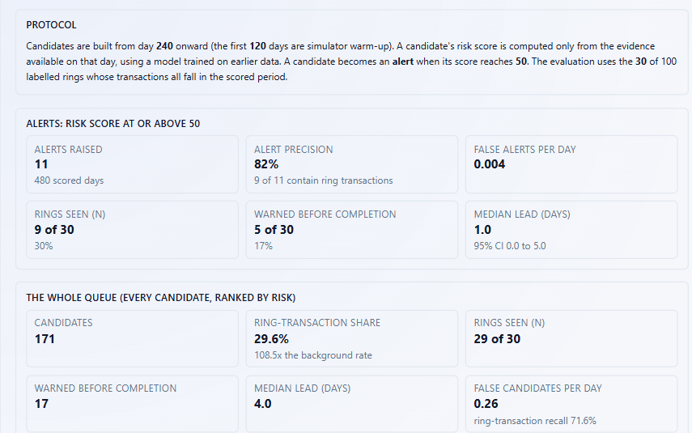
Lead time is measured against ring completion
MODULE 8 · EVALUATION | LEAD-TIME ANALYTICS page
Lead = completion day minus warning day; positive means the ring was warned before it completed
4.0 days
1.0 day
median lead, whole queue (17 of 30 early)
median lead, alerts (5 of 30 early; 95% CI 0 to 5)
0 rings were warned after completion
Notes:
The Lead-Time page states the protocol and then reports two views. Alerts, candidates that reached a score of 50, are 82 percent precise with 0.004 false alerts per day, see 9 of the 30 evaluable rings, and warn before completion for 5, with a median lead of 1 day and a 95 percent interval of 0 to 5. The whole queue, every candidate, sees 29 of 30 rings and warns before completion for 17, with a median lead of 4 days, at the cost of 0.26 false candidates per day. The stacked bar shows how each of the 30 rings was warned: before completion, exactly at completion, or never. Nobody was warned after completion.

Slide 17
The threshold is a dial, and we report the range
MODULE 8 · EVALUATION | LEAD-TIME ANALYTICS page
Six alert thresholds on the same rings, and the spread over five retrainings of the behavioural model
Stability over 5 retrainings (queue figures cannot move)
Measure | This run | Range
Alerts raised | 11 | 11 to 16
Alert precision | 82% | 82% to 88%
Rings seen (of 30) | 9 | 9 to 13
Warned before completion | 5 | 5 to 6
Median lead (days) | 1.0 | 0.0 to 1.0
Ranking AUC | 0.78 | 0.76 to 0.78
Alert precision by threshold: 28%, 28%, 33%, 86%, 82%, 89% (30 to 55); false alerts per day fall from 0.256 to 0.002.
Notes:
Lowering the threshold sees more rings and warns earlier but raises false alerts. At 30 the alerts see 29 of 30 rings but precision is 28 percent; at 45 there are 29 alerts at 86 percent precision and 24 rings seen; at the configured 50 there are 11 alerts at 82 percent and 9 rings seen. Because many candidates score just below 50, the alert-level numbers move when the behavioural model is retrained: across five seeds, alerts range from 11 to 16, rings seen from 9 to 13, and early warnings from 5 to 6. The queue-level figures cannot move because they do not depend on the score. So we quote ranges, not single values. The threshold of 50 was fixed before the evaluation; choosing 45 now would be tuning on the results.

Slide 18
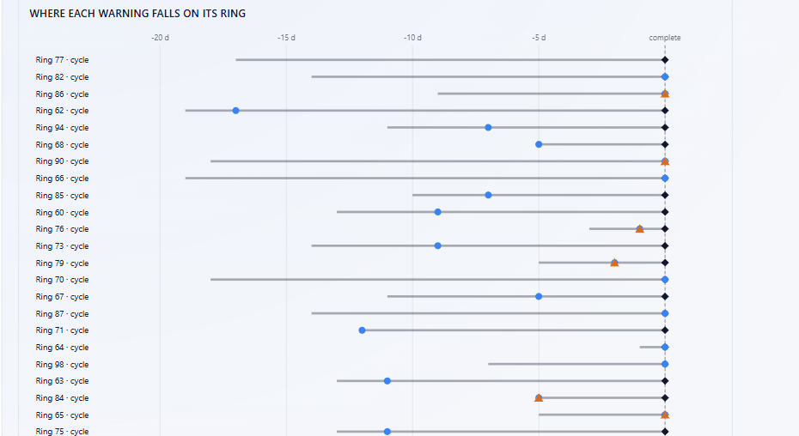
Every ring, aligned at the day it completes
MODULE 8 · EVALUATION | WARNING TIMELINE page
Blue marks the first candidate that held the ring; orange marks the alert; the dashed line is completion
Lead time of the nine alerted rings
Ring (candidate) | Lead (days)
95 (RING0160) | 10
84 (RING0136) | 5
81 (RING0161) | 4
79 (RING0119) | 2
76 (RING0101) | 1
86, 90, 65, 72 | 0
The queue warned earlier on rings that never alerted: ring 62 by 17 days, ring 71 by 12. Only ring 77 was never seen.
Blue = candidate warning (queue) | Orange = alert | Diamond = ring complete
Notes:
The Warning Timeline aligns every evaluable ring at the day it completes, so a marker to the left of the line is a warning that came before the ring was complete. Blue is the first day a candidate holding the ring's transactions existed, and orange is the day such a candidate reached the alert threshold. The table on the right lists the nine alerted rings: the earliest alert came 10 days ahead, on ring 95 through RING0160, then 5, 4, 2 and 1 days, and four rings were alerted exactly at completion. The queue warned much earlier on rings that never alerted, for example ring 62 by 17 days. Only ring 77 was never seen.

Slide 19
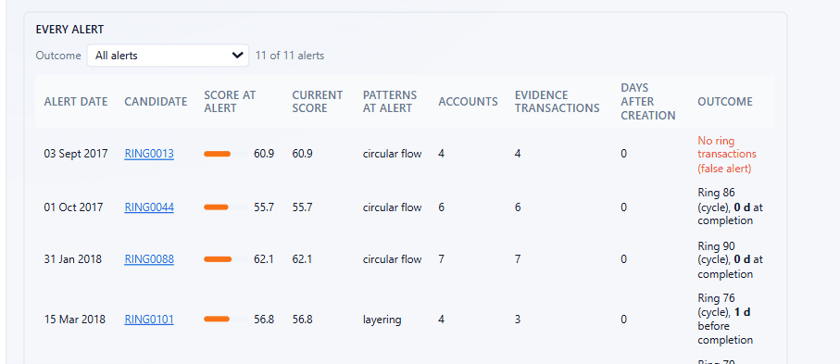
Eleven alerts, each with its own verdict
MODULE 6 · ALERT RULE + QUEUE | ALERT LOG page
Score then and now, patterns then and now, and what the ground truth says afterwards
RING0160: one alert, two readings
Alerted as layering on 30 Oct 2018 (score 51.9), 10 days before ring 95 completed
Closed into a cycle on 9 Nov; the log reads 'layering, now: circular flow'
All five early alerts involve layering. The four true circular-flow alerts arrived exactly at completion.
9 of 11
2 false
3 fell below 50
hold ring transactions (82%)
RING0013 (clean 4-account cycle), RING0148 (2-transaction fan-out)
RING0136, RING0142, RING0160; the alert stays on record
Notes:
The Alert Log lists every alert with its date, the score at the alert and the current score, the patterns at the alert, the evidence size, and the outcome. Nine of the eleven alerts hold ring transactions. The two false alerts are RING0013, a clean four-account circular flow, and RING0148, a fan-out of only two transactions. Three alerts later fell below 50, which is why the page keeps both scores. RING0160 shows why the log records the patterns at the alert: it alerted as layering on 30 October, closed into a cycle on 9 November, and the log shows layering, now circular flow. All five early alerts involve layering; the four true circular-flow alerts arrived exactly at completion.

Slide 20
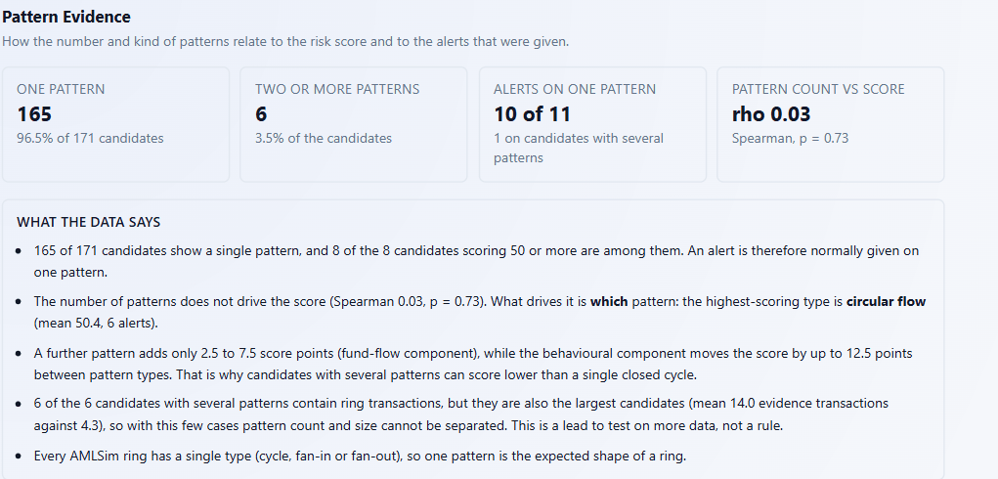
Which pattern matters, not how many
MODULE 3 and 8 · PATTERN EVIDENCE | PATTERN EVIDENCE page
Pattern count and score are unrelated (Spearman 0.03, p = 0.73); the type of pattern is not
123 of the 124 candidates with no ring transaction are fan-out groups
A second pattern adds only 2.5 to 7.5 points; the behavioural component moves the score by up to 12.5
The 6 multi-pattern candidates are also the largest (14.0 against 4.3 transactions), so size and pattern count cannot be separated
Notes:
Of 171 candidates, 165 show one pattern and only 6 show several, and all 8 candidates scoring 50 or more are single-pattern. The chart shows the share of candidates of each pattern type that hold a ring transaction: 13 of 14 circular flows, all 16 layering, all 6 fan-in and all 6 multi-pattern candidates, but only 6 of 129 fan-outs, which is 5 percent. So 123 of the 124 candidates that hold no ring transaction are fan-out groups. A second pattern adds only 2.5 to 7.5 points while the behavioural component moves the score by up to 12.5, and the six multi-pattern candidates are also the largest, so pattern count and size cannot be separated with six cases.

Slide 21
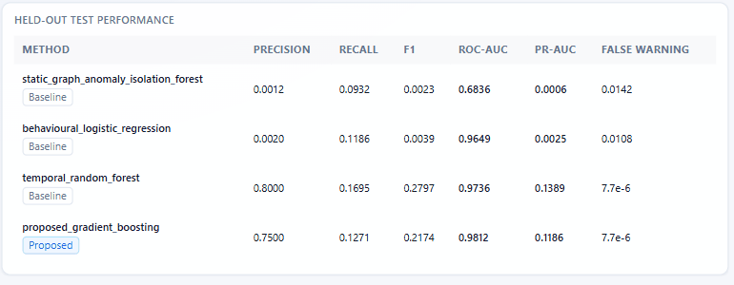
Four model families, one chronological protocol
MODULE 4 · BEHAVIOUR MODEL | MODEL PERFORMANCE page
14-day forecast on 653,487 test rows with 118 positives (0.0181%); thresholds chosen on validation, test scored once
The temporal random forest leads precision (0.80), recall, F1 and PR-AUC (0.139); the proposed model leads ROC-AUC (0.981)
Precision at 10, 20, 50 for the proposed model: 80%, 75%, 60%
Our claim is the pipeline, not a better classifier
Notes:
All four families, a static-graph isolation forest, a behavioural logistic regression, a temporal random forest and the proposed gradient boosting model, are evaluated under exactly the same protocol. The test set is extremely imbalanced, so accuracy is meaningless and we report precision, recall, F1 and PR-AUC. The proposed model has precision 0.75, recall 0.127 and PR-AUC 0.119, the highest ROC-AUC at 0.981, and 80, 75 and 60 percent precision at 10, 20 and 50. The temporal random forest is slightly ahead on precision, recall, F1 and PR-AUC. With only 118 positives the gap is small, so our claim is the pipeline of candidates, explanation and early-warning evaluation, not a better classifier.

Slide 22
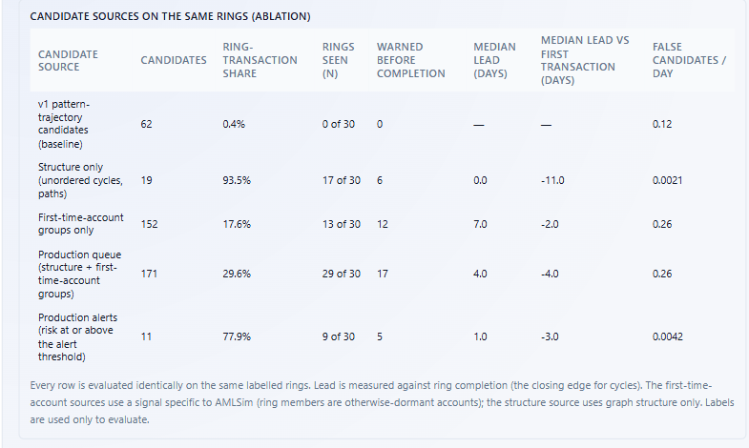
The control that changes the story
MODULE 2 and 8 · ABLATIONS & CONTROLS | ABLATIONS & CONTROLS page
A two-bit newness rule detects as many rings as the learned model: the early signal is the simulator's dormant accounts
Without novelty the model detects 3% to 53% of rings, close to random (10% to 40%)
Validate on real data before any production claim
Notes:
This is the most important control in the project. The newness rule flags a transaction if its sender or receiver has never transacted before; it is two bits of information. At one to ten flagged transactions per day it detects all 30 rings, exactly like the model with novelty features. The same model without novelty features detects only 3 to 53 percent, close to a random policy at 10 to 40 percent. In AMLSim, ring members are drawn from otherwise dormant accounts, so a first-time account is unusually informative. We report this openly: the result is real for the simulator, and real data would have to confirm it, which is why Elliptic2 validation is the first item of future work.

Slide 23
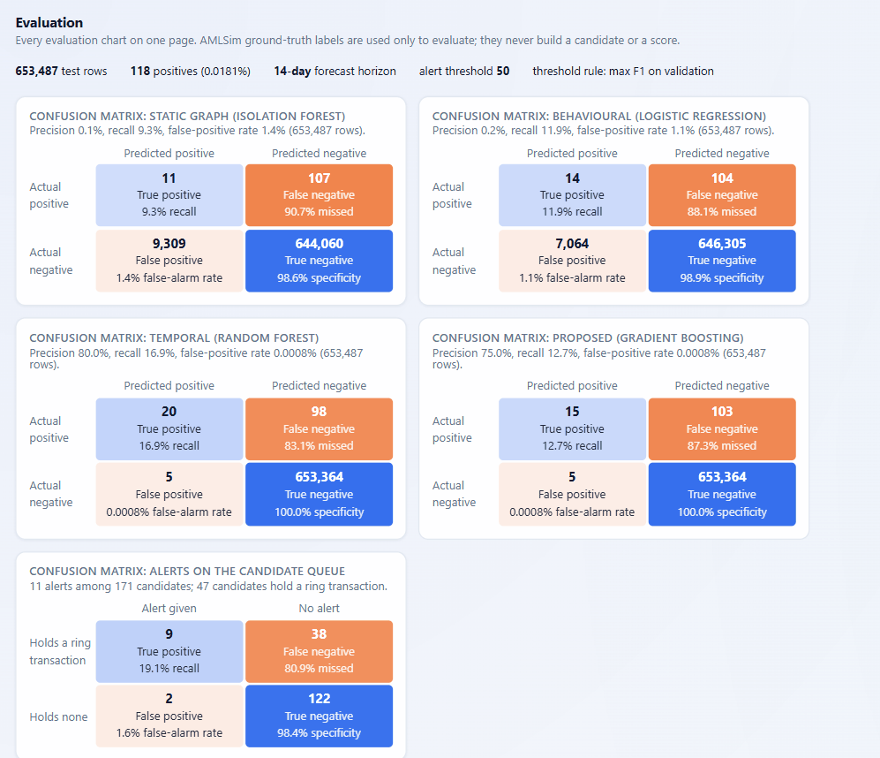
Five confusion matrices, all from real counts
MODULE 8 · EVALUATION | EVALUATION page (confusion matrices)
Four forecast models on 653,487 test rows, and the alerts on the 171 candidates
15
5
103
true positives (proposed model)
false positives
missed positives
653,364 correct negatives out of 653,487 test rows; false-alarm rate 0.0008%
Alerts on 171 candidates: 9 true alerts, 2 false alerts, 38 ring candidates without an alert, 122 true negatives.
Notes:
The Evaluation page puts every evaluation chart on one page. It starts with five confusion matrices, drawn from the stored counts and not estimated. For the proposed model: 15 true positives, 5 false positives, 103 missed positives and 653,364 true negatives, which adds up to the 653,487 test rows. Blue cells are correct and orange cells are errors, and the intensity is the share of that row. Precision is 75 percent, so three of four flags are real, but recall is 12.7 percent, so most positives are still missed. The fifth matrix is for the alerts on the 171 candidates: 9 true alerts, 2 false alerts, 38 candidates that hold a ring transaction but had no alert, and 122 true negatives.

Slide 24
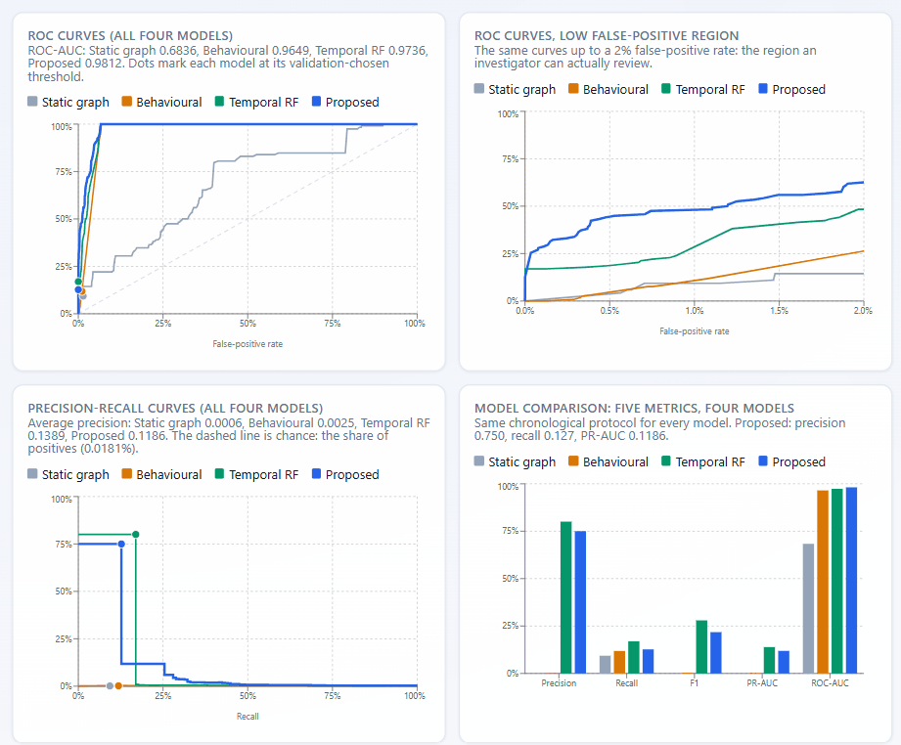
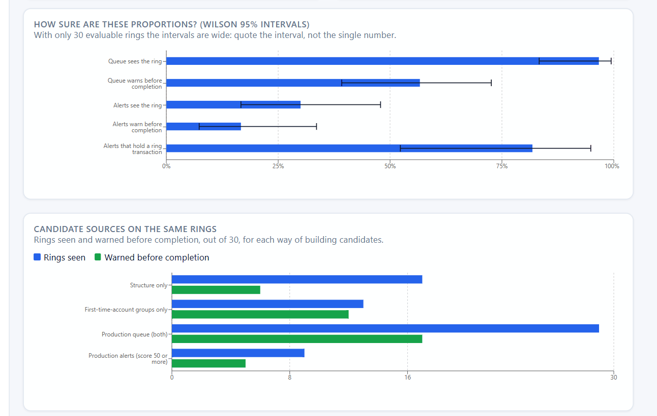
ROC, precision-recall and honest intervals
MODULE 8 · EVALUATION | EVALUATION page (curves and uncertainty)
The curves come from the same scores as the reported metrics, and the intervals show how little 30 rings can prove
ROC (full and zoomed), precision-recall, model comparison
Wilson 95% intervals and candidate sources on the same rings
Notes:
Below the matrices the Evaluation page draws the ROC curves for all four models, a zoom on the low false-positive region where an investigator can actually work, and precision-recall step curves. The curves are computed from the same scores as the reported metrics and are checked against them; the page refuses a curve file from a different run. On the right, Wilson 95 percent intervals show the honest uncertainty with only 30 rings: for example, alerts warning early for 5 of 30 rings could truly be anywhere from 7 to 34 percent. Further down the page are the candidate sources, the controls and the horizon sensitivity we have already discussed.

Slide 25
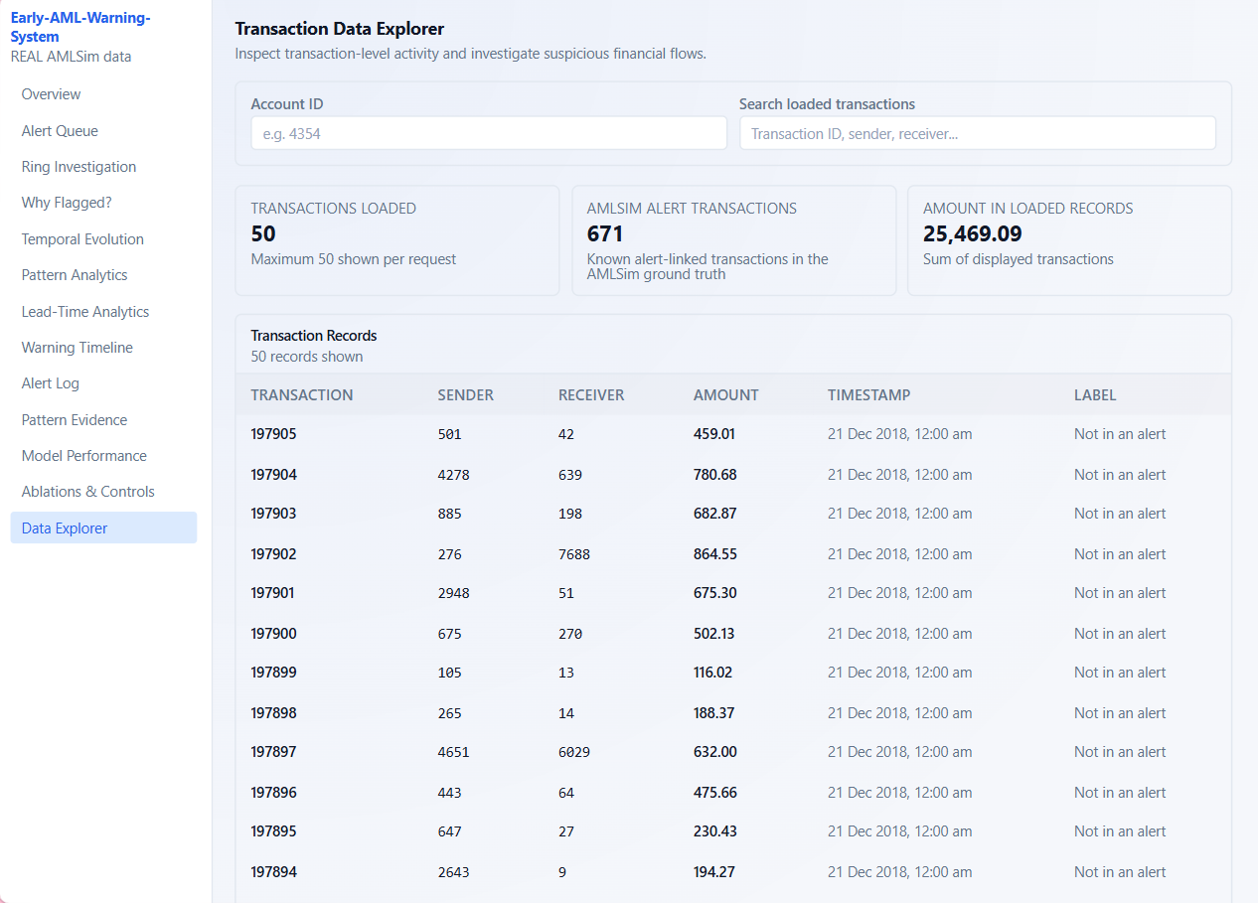
Every number traces back to a transaction
MODULE 1 and 7 · DATA + EVIDENCE | DATA EXPLORER page
The explorer lists raw transactions; ground truth appears only as a label, never as an input
1
Traceable
Candidates link to accounts, flows and transaction IDs
2
Separated
Ground truth is a label column and an evaluation box, never an input
3
Reproducible
A fresh clone rebuilt 13 of 13 key result files byte-identical; 21 API endpoints answer
4
Honest
Missing data shows 'Not yet evaluated', never a made-up number
Notes:
The Data Explorer is the bottom of the evidence chain: every candidate, score and alert can be traced down to individual transactions here, with the AMLSim label shown as a separate column called Not in an alert. We built four forensic principles into the system. Traceability: candidates link to accounts, flows and transaction IDs. Separation: labels are used only to evaluate. Reproducibility: a fresh clone of the repository rebuilt all 13 key result files byte-identical and answered all 21 API endpoints. Honesty: missing data shows as not yet evaluated, never as a made-up number.

Slide 26
Review feedback, addressed one by one
Four points raised in the last review, each now backed by a measured result on the dashboard
Review feedback | What we delivered | Where to see it
No lead detection time was calculated | Lead time on 30 evaluable rings: queue median 4.0 days (17 early); alerts 1.0 day (5 early, 95% CI 0 to 5) | Lead-Time Analytics, Warning Timeline
High false alarm | 2 of 11 alerts are false (0.0042 per day); the first version left 88 of 89 alerted candidates unmatched | Alert Log, Lead-Time Analytics
Class imbalance | PR-AUC, precision at K, confusion matrices and Wilson intervals instead of accuracy: 118 positives in 653,487 rows | Model Performance, Evaluation
Ground truth not matching | Label-free candidates now match the rings: 29 of 30 seen; 29.6% of candidate transactions are ring transactions (108.5 times the background) | Overview, Alert Queue
Honest note: class imbalance is managed, not solved; recall is still 12.7%.
Notes:
These are the four points from the last review. No lead time was calculated: it now is, on 30 rings, with a median of 4 days for the queue and 1 day for the alerts. High false alarm: only 2 of 11 alerts are false, where the first version left 88 of 89 alerted candidates unmatched. Class imbalance: we stopped relying on accuracy and report PR-AUC, precision at K, confusion matrices and Wilson intervals, although recall is still only 12.7 percent, so we say it is managed, not solved. Ground truth not matching: candidates are now label-free and match the rings, 29 of 30 seen.

Slide 27
Six findings, told honestly
What the measured results really say, including the uncomfortable ones
1
Early alerts come from layering
2
The queue holds the earlier signal
3
The threshold is fragile
All five early alerts involve layering (leads 1, 2, 4, 5, 10 days); closed cycles confirm only at completion.
17 of 30 rings warned early by the queue against 5 by alerts: the score, not detection, is the bottleneck.
Three candidates score 49.3 to 49.4 without an alert; alerts range from 11 to 16 across retrainings.
4
The early signal is a shortcut
5
The proposed model is not the best classifier
6
Thirty rings limit the claims
A two-bit newness rule matches the model; without novelty features the model is close to random.
The random forest leads PR-AUC (0.139 against 0.119); our contribution is the pipeline.
Alerts warn early for 17% of rings (interval 7% to 34%); the 60 fan rings are not evaluable yet.
Notes:
These are the findings we would want an examiner to hear from us first. One: every early alert involves layering, while closed cycles confirm only at completion. Two: the queue holds an earlier signal than the alerts use, 17 rings against 5, so the score is the bottleneck, not detection. Three: the threshold is fragile, with three candidates at 49.3 to 49.4 and alert counts from 11 to 16 across retrainings. Four: the early signal is largely a simulator shortcut, since a two-bit newness rule matches the model. Five: the proposed model is not the best classifier; the random forest leads on PR-AUC. Six: with 30 rings, the intervals are wide and the 60 fan rings are not evaluated.

Slide 28
Limits we state up front, and what comes next
Every limit on the left is already stated on the dashboard; every step on the right closes one of them
Limits
What comes next
Only 30 of 100 rings are evaluated (all cycles); 60 fan rings and 10 early cycles are not
Part of the early signal is AMLSim's dormant-account construction
Alert-level numbers move with retraining: alerts 11 to 16
Threshold 50 was fixed in advance, so results are sensitive to it
Recall is 12.7%: class imbalance is managed, not solved
No real-data validation and no published temporal-GNN baseline yet
Evaluate the 60 fan rings with a truncated-observable definition
Validate on real data (Elliptic2) and add a temporal-GNN baseline
Generate more AMLSim rings to narrow the intervals
Re-run the original multi-feature models under the validated protocol
Reconstruct each ring: accounts and transactions recovered
Investigate why scores fade after a candidate's first day
Notes:
We prefer to state limits before they are found. Only 30 of the 100 rings are evaluable and all are cycles; the 60 fan rings and 10 early cycles start before the scored period. Part of the early signal comes from how AMLSim builds rings. Alert-level numbers move with retraining, and the threshold was fixed in advance. Recall is 12.7 percent. There is no real-data validation yet. The next steps map one-to-one onto these limits: evaluate fan rings with a truncated definition, validate on Elliptic2 and add a published temporal graph neural network baseline, generate more AMLSim rings, re-run the original multi-feature models under the validated protocol, reconstruct each ring, and investigate why scores fade after the first day.

Slide 29
Everything we delivered
One repository, one command to rebuild every result, and a dashboard that explains each of them
171
179
30
14
label-free candidates, scored as of each day
pattern events in 4 types
rings evaluated for lead time (queue 17 early, alerts 5)
dashboard pages and 21 verified API endpoints
13 of 13
100 + 253
README + HTML
1 command
key result files rebuilt byte-identical from a fresh clone
automated tests (12 legacy tests of retired modules fail, as documented)
documentation with figures from the final dashboard
rebuilds every result: rebuild_v2.py all
Notes:
This slide is the inventory. The pipeline produces 171 label-free candidates and 179 pattern events and scores them as of each day. Thirty rings are evaluated for lead time. The dashboard has 14 pages and 21 API endpoints that we verified on a fresh clone of the repository, where all 13 key result files were rebuilt byte-identical. There are 100 page tests, run in the India time zone, and 253 backend tests, of which 12 legacy tests of retired modules fail, and that is documented. The README and a self-contained HTML explainer carry the figures from the final dashboard, and one command, rebuild_v2 all, regenerates everything.

Slide 30
How early
can we know?
Before the ring completes for 17 of 30 rings, a median 4 days ahead. Precisely, but later, for 5 of 30.
The signal is real in AMLSim. The shortcut is real too. Both are now measured.
Thank you | Questions?
Notes:
Close by answering the opening question. With the whole candidate queue we warn before the ring completes for 17 of 30 evaluable rings, a median of four days ahead. With the precise alerts we warn early for 5 of 30. We also found that part of the early signal is a property of the simulator, and we measured that instead of hiding it. Thank the examiners and invite questions; the viva preparation sheet has answers to the likely ones.

